Slide 1
cancor
‘Experience the ultimate nightlife destination with a unique ambiance, signature cocktails, and delicious cuisine at the first bar of lamjung’

Slide 2
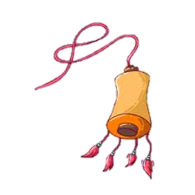
objectives
To develop a basic understanding of HTML and CSS, the two main technologies used for building websites.
To understand the basic concepts of responsive design and how to make a website mobile-friendly.

Slide 3

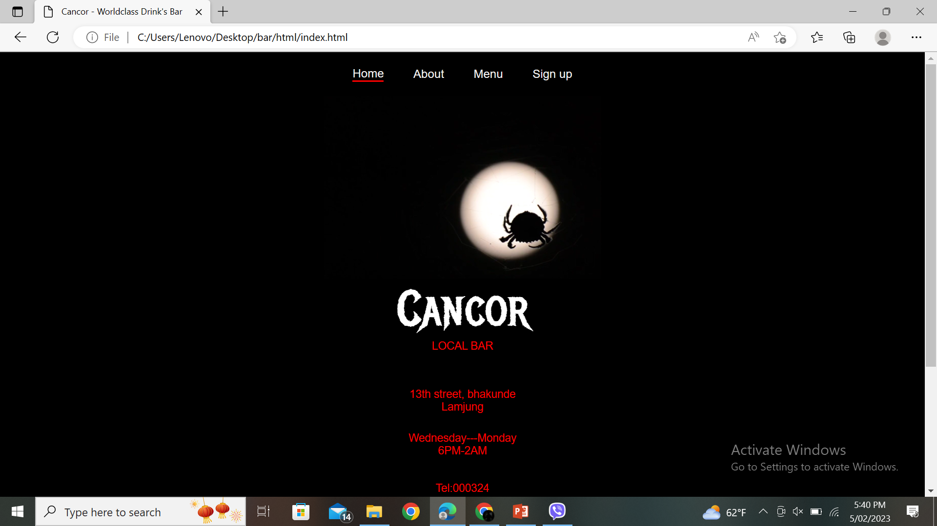
INTRODUCTION
First of the town,cancor is the ultimate destination for nightlife entertainment. It is designed to provide an unforgettable experience with a unique ambiance and signature cocktails. Whether you're looking for a relaxing evening with friends or a night out on the town, Cancor has something for everyone. Our menu features a variety of beers, wines and signature cocktails, all expertly crafted by our talented bartenders. With a prime location and friendly, professional service, Cancor is the perfect place to unwind, socialize, and make memories that will last a lifetime.

Slide 4
Technology used
1
2
3
Visual Studio Code
css
HTML

Slide 5

Future enhancement
Online ordering and delivering
Online reservations
Virtual tours
Online store
Virtual events and many more…

Slide 6


conclusion
In conclusion, I am proud to have learned HTML and CSS and to have created my own website. This project has allowed me to gain valuable skills in web development and has given me the opportunity to showcase my creativity and technical abilities. I am grateful for this learning experience and I look forward to continuing to develop my skills in this field.

